Slide 1
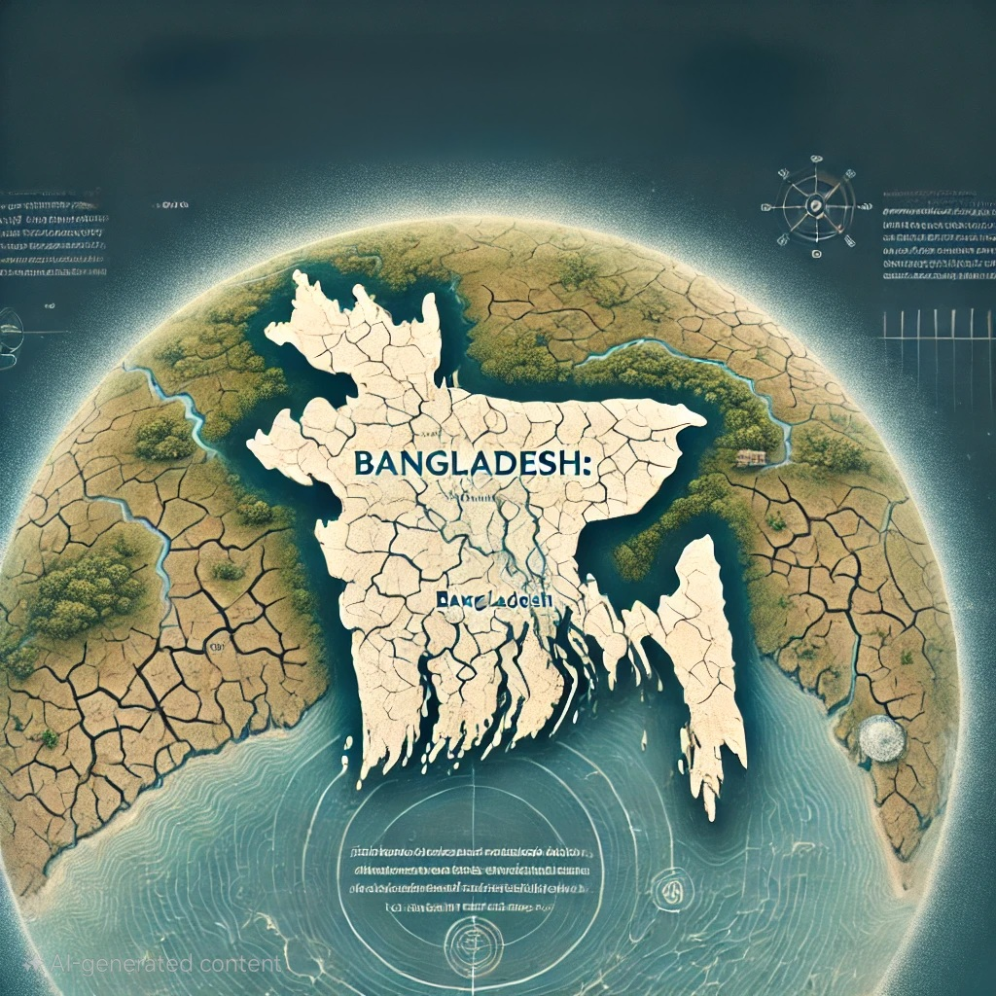
Increase in Water and Soil Salinity in Bangladesh: Causes, Impacts, and Solutions
Presented By Sakib Al Hasan

Slide 2


HASINA AFRUJ SHANTA
PRESENTED TO:
Associate Professor
Department of Political Science
University of Chittagong

Slide 3
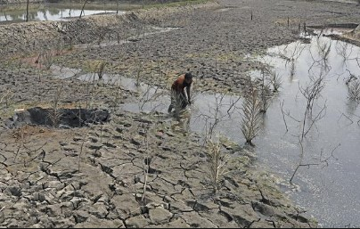
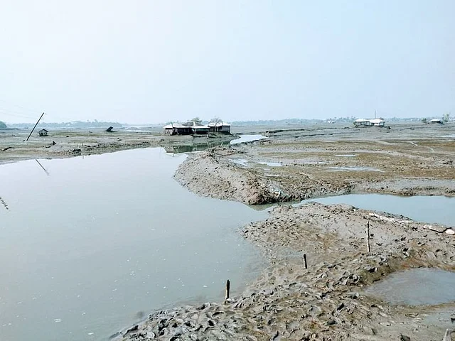
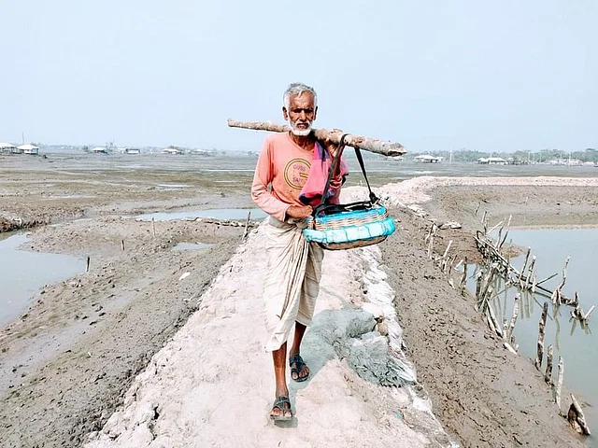
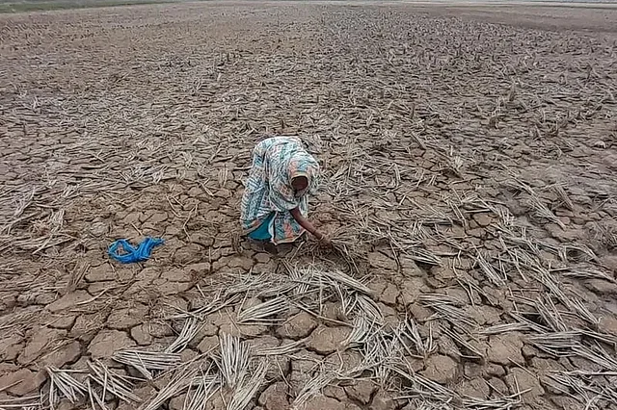
Increase in salinity
An increase in soil and water salinity refers to a constant increase in the concentration of dissolved salts in soil layers and water, which has a detrimental influence on environmental balance and biodiversity. In Bangladesh, particularly in coastal regions, rising sea levels and floods have allowed salty water to penetrate agricultural lands, freshwater sources, and deeper soil layers. As a result, soil fertility falls, there is a lack of safe drinking water, and agricultural productivity diminishes.

Slide 4
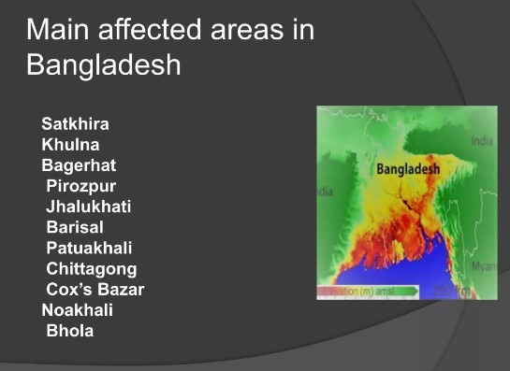
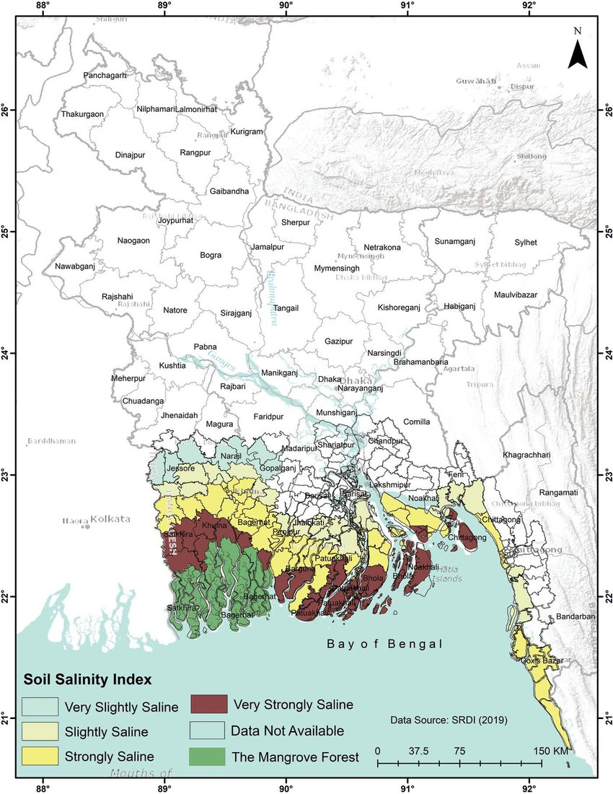
Salinity in Bangladesh
Regions where salinity issues are severe.

Slide 5
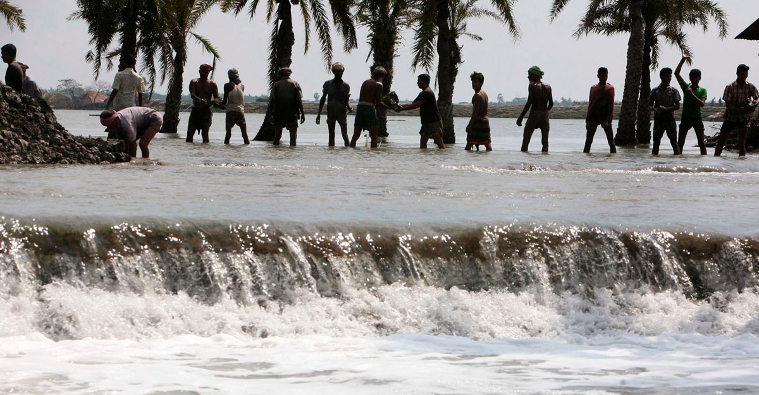
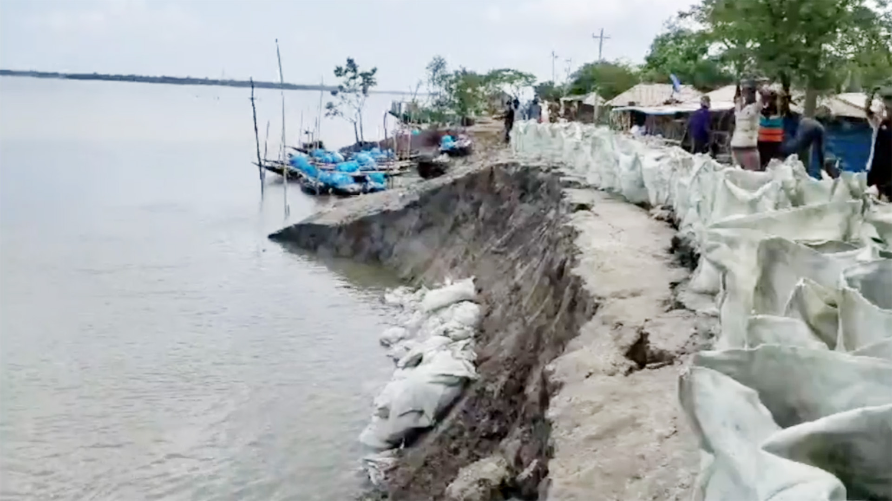
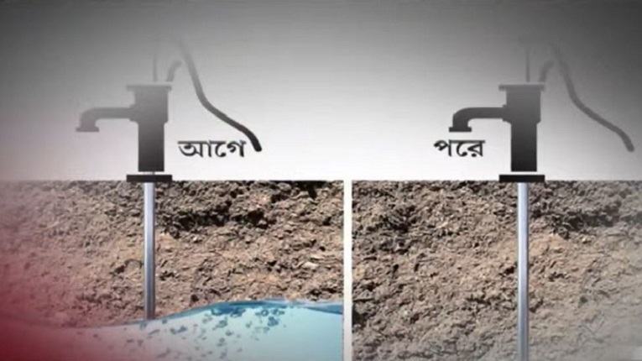
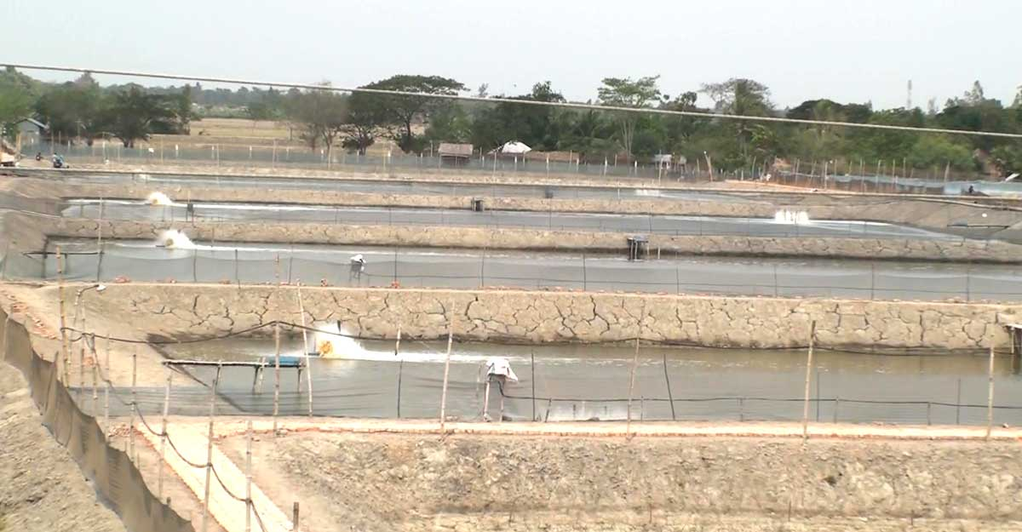
Causes of increased salinity.
1. Climate Change:
Rising sea levels lead to increased salinity in coastal regions.
Extreme weather occurrences, such as cyclones, exacerbate the entrance of salt water.
2. Tides and Flooding:
Frequent tidal surges and river embankment breaches cause salty water to penetrate inland regions.
3. Overwhelming Demand on Groundwater Use:
Excessive groundwater extraction leads to salty water seeping into subsurface aquifers.
4. Human Activities:
Adding salty water to freshwater sources for shrimp cultivation.

Slide 6
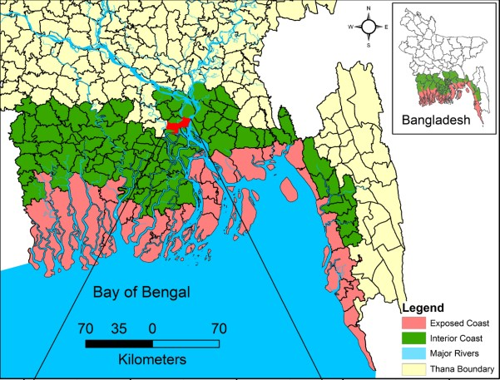
Rate of increase in salinity
Salinity levels are rising in Bangladesh's coastal areas, having a severe impact on agriculture and biodiversity. In 1973, around 8% of the land was saline, but by 2024, this percentage had increased to over 30%. As a result of this development, agricultural land is being exploited for shrimp farming, which has a negative impact on the environment.
The pace of salinity growth is connected to increasing sea levels. The sea level in the Cox's Bazar region rises by 7.8 millimeters each year on average, submerging huge swathes of the coastline.

Slide 7
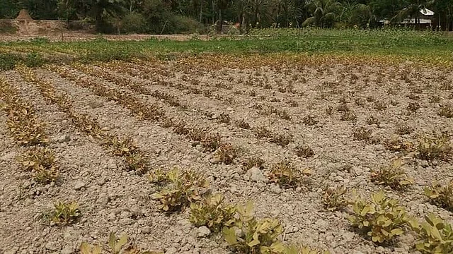
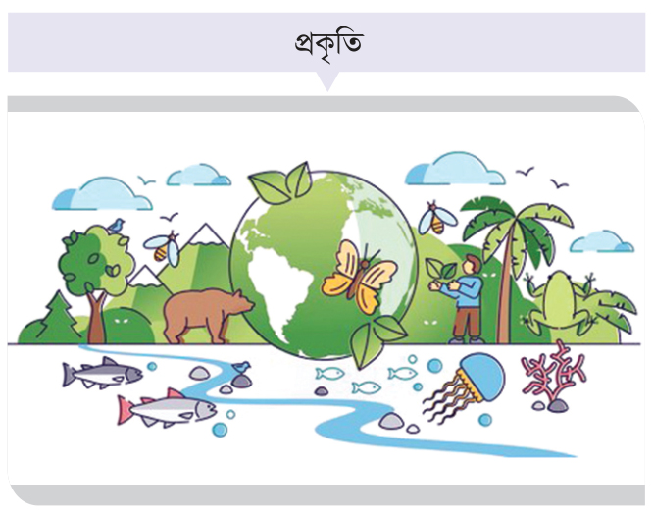
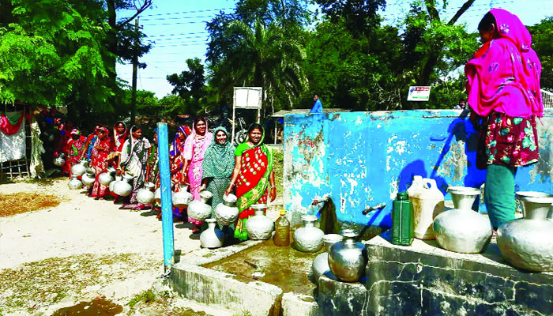

Impact of salinity
1. Agriculture and Food Security
Rising salinity is affecting agricultural output.
It threatens food security.
2. Biodiversity
Salinity is leading to the extinction of several animal and plant species. - The rise in salt in wetlands has a deleterious influence on freshwater species.
3. Human Health
Using saline water increases the risk of waterborne infections.
Direct health consequences include skin problems, high blood pressure, and so forth.
4. Ecosystems and Displacement
Coastal people are being relocated.
There are implications for livelihoods and ecosystems.

Slide 8
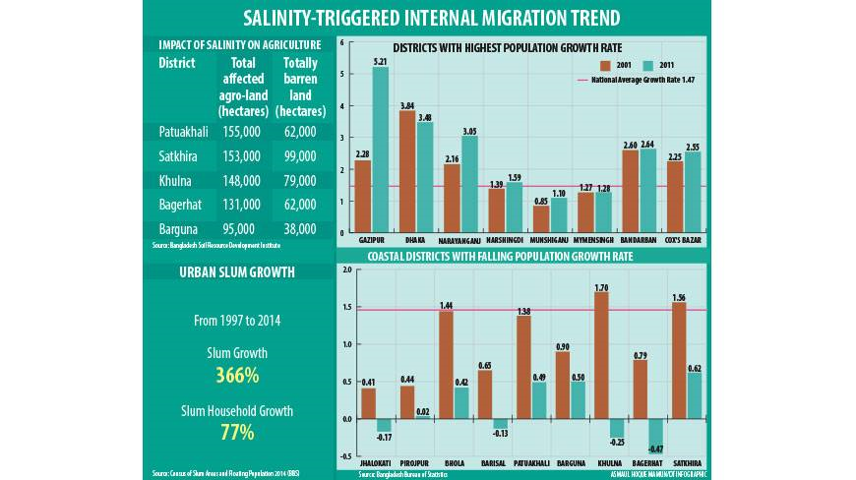
Impact of salinity
This infographic depicts the pattern of internal migration and its effects as salt levels rise in Bangladesh. Coastal regions in the districts of Patuakhali, Satkhira, Khulna, Bagerhat, and Barguna have been severely damaged by salt, affecting hundreds of thousands of hectares of agricultural land, some of which has become entirely unproductive. while a result, many people in these regions are relocating to other parts of the country in pursuit of a living, while agricultural operations have declined. As a result, population growth rates in districts like as Gazipur, Dhaka, and Narayanganj have outpaced the national average, while coastal areas have seen a dip.
Because of the salinity, residents from coastal areas have relocated to cities, resulting in a 366% rise in urban slums and a 77% increase in slum families between 1997 and 2014. This emphasizes the long-term repercussions of salt rise, which affect not just the environment but also have substantial social and economic implications.

Slide 9
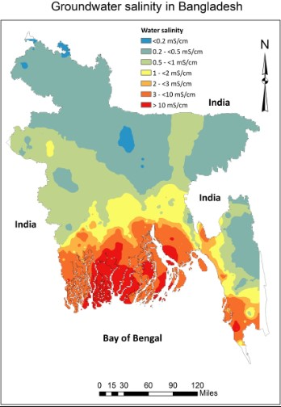
Impact of salinity
The salinity of drinking water in Bangladesh's coastal districts is a serious issue. Rising sea levels, frequent storms, and cyclones are causing salty water to mix into coastal rivers and groundwater supplies. As a result, individuals in these areas typically have limited access to fresh water and must rely on saltwater water.
The use of saline drinking water causes a variety of health concerns, including high blood pressure, skin disorders, and pregnancy-related health hazards. Furthermore, persistent salty water drinking increases the risk of renal diseases. Due to water shortages, many households must gather water from remote regions, which is both time-consuming and difficult.

Slide 10
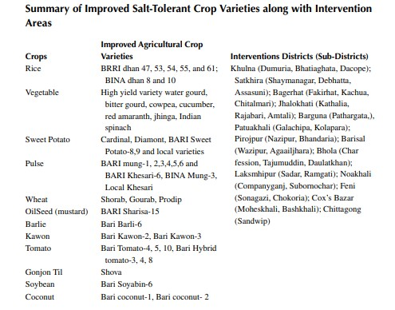

Slide 11
Measures to combat salinity.
Increase in Afforestation
Administrative Measures
Awareness and Training
Salinity Management
Expansion of International Cooperation
Sustainable Shrimp Farming Plans

Slide 12
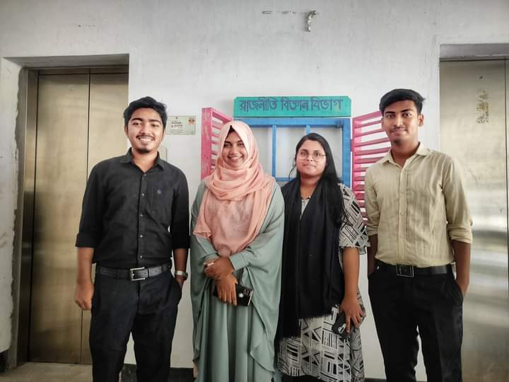
Thanks
For your valuable time to listen us.
Tutorial group “Cha”
Session: 2019-20
Department of Political Science
University of Chittagong

Slide 13
References
https://www.researchgate.net/figure/Soil-salinity-map-of-coastal-Bangladesh_fig3_351534229
https://en.prothomalo.com/environment/i5psxklovu
https://icccad.net/dhaka-tribune-articles/salinity-triggered-migration-now-alarming
https://www.aa.com.tr/en/asia-pacific/climate-driven-salinity-posing-serious-threats-to-pregnant-women-child-health-in-bangladesh/2856558
https://www.researchgate.net/figure/Drinking-water-salinity-electrical-conductivity-levels-across-Bangladesh_fig1_339323281

